Slide 1
Security Information and Event Management Mentor: Mr. Jatin Sethi
Bineek Raja, Vikash Anand, Vandana Sharma, Mohit Pandey
B-Tech Computer Science Engineering with Specialization in BFSI – 7th Semester

Slide 2
Abstract
Security information and event management (SIEM) technology supports threat detection and security incident response through the real-time collection and historical analysis of security events from a wide variety of event and contextual data sources. The core capabilities of SIEM technology are a broad scope of event collection and the ability to correlate and analyze events across disparate sources. There is a need to provide cost effective open source application that can provide threat detection through real time analysis of security alerts generated by network components which would be helpful for small organisations.
This application will provide real-time monitoring, correlation of events, notifications, console views and provides long-term storage as well as analysis, manipulation based on reporting of log data and security records.

Slide 3
Introduction
Security information and event management (SIEM) software products and services combine security information management (SIM) and security event management (SEM). They provide real-time analysis of security alerts generated by network hardware and applications.
The segment of security management that deals with real-time monitoring, correlation of events, notifications and console views is known as security event management (SEM). The second area provides long-term storage as well as analysis, manipulation and reporting of log data and security records of the type collated by SEM software, and is known as security information management (SIM).
The term security information event management (SIEM), coined by Mark Nicolett and Amrit Williams of Gartner in 2005,
The product capabilities of gathering, analyzing and presenting information from network and security devices
Identity and access-management applications
Vulnerability management and policy-compliance tools
Operating-system, database and application logs
External threat data
A key focus is to monitor and help manage user and service privileges, directory services and other system-configuration changes; as well as providing log auditing and review and incident response.

Slide 4
Objective
To develop an application which can provide real-time monitoring, correlation of events, notifications, console views and provides long-term storage as well as analysis, manipulation and reporting of log data and security records.

Slide 5
Problem Statement
There is a need to provide cost effective open source application that can provide threat detection through real time analysis of security alerts generated by network components which would be helpful for small organisations.

Slide 6
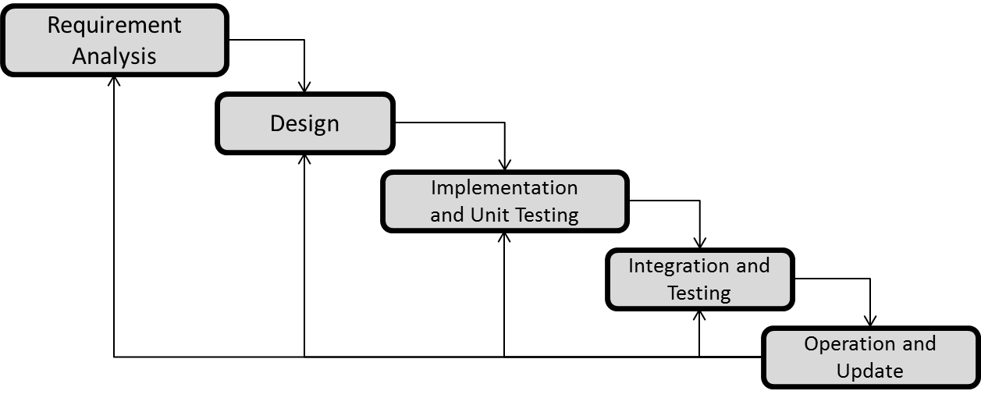
Methodology
We are using ITERATIVE WATERFALL MODEL due to large data size and complexity of our project.

Slide 7
1 Requirement Analysis:
Data modelling that is collection of data which will be used as input and output.
2 System Designing:
An algorithm will be developed on the basis of formulas and data that are collected and these data will be sampled as input in further phase. The algorithm will decrease the time complexity and will finally give an automated system for all the calculations under a single dashboard.
3 Implementation and Unit Testing:
We will develop the software using the algorithm developed during design phase in Python Language. The software will be developed in two modules and will be tested separately.
4 Integration and Testing:
The modules developed will be integrated to develop the software and tested by using the sample data collected during the analysis phase.
5 Operation and Update:
The final software developed will be deployed and updated according to the bugs which will be encountered.

Slide 8
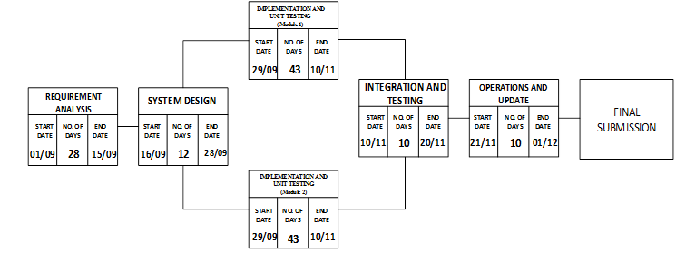
Pert Chart
System Design
Collection of Logs
Reformation of different logs in a standard format.
Event management at firewall.
Basic UI Design

Slide 9
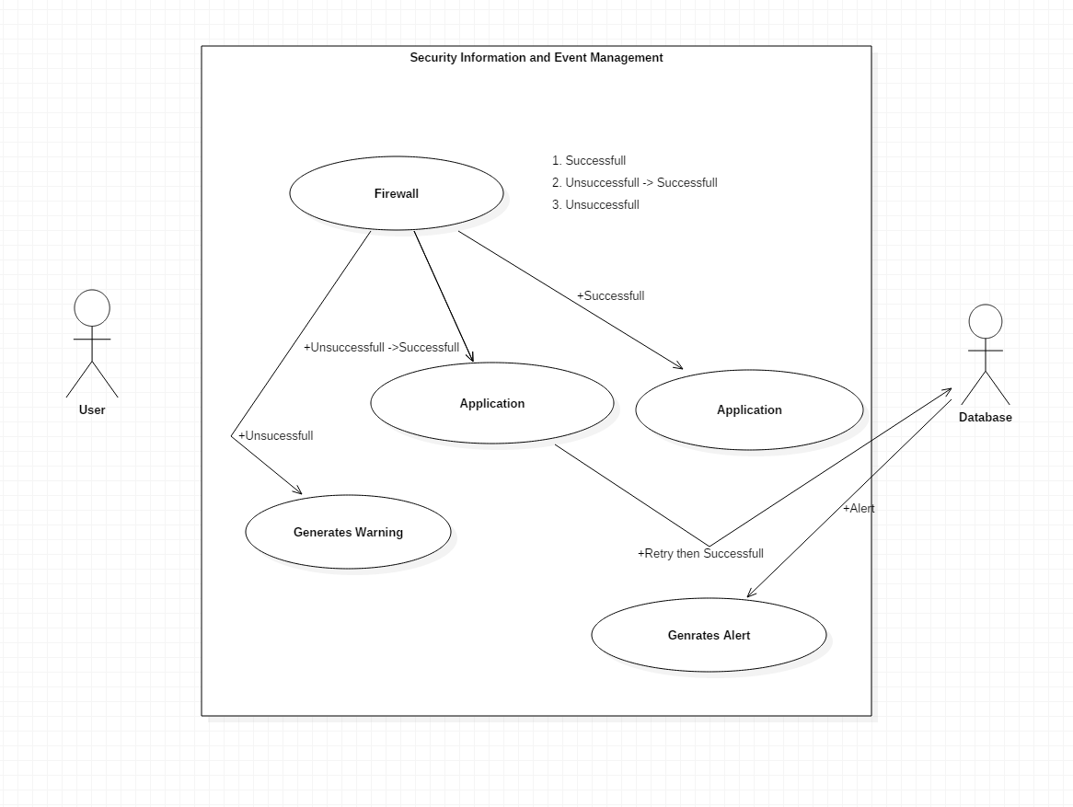
Use Case Diagram

Slide 10
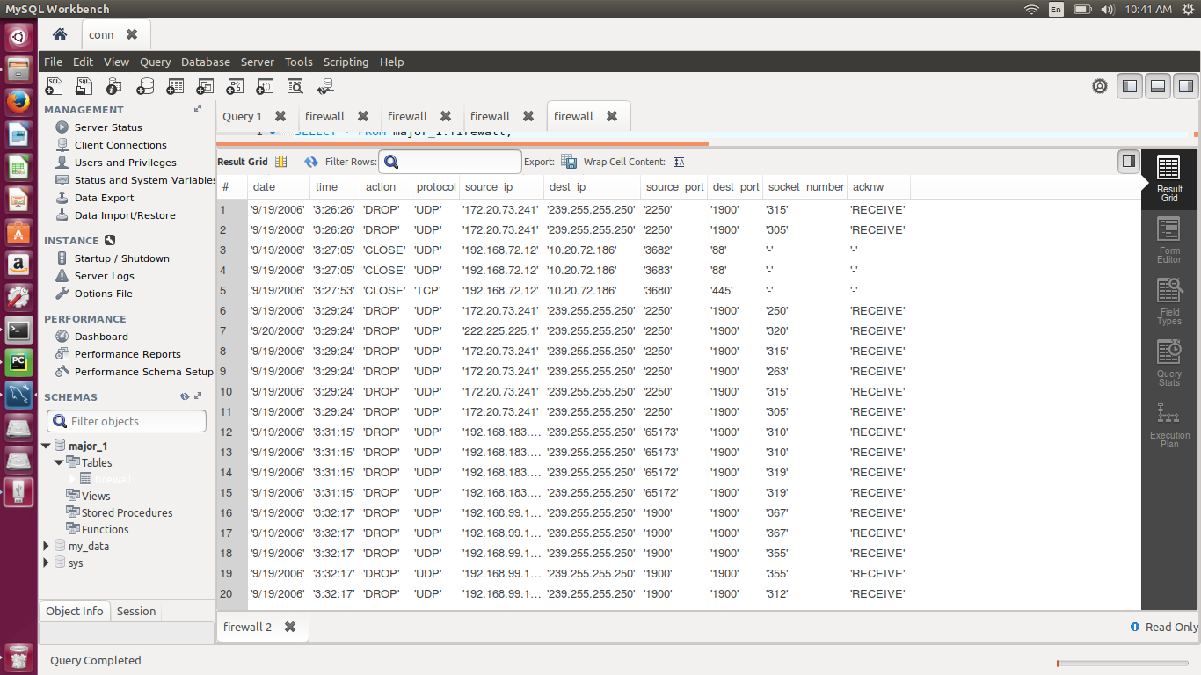
Database

Slide 11
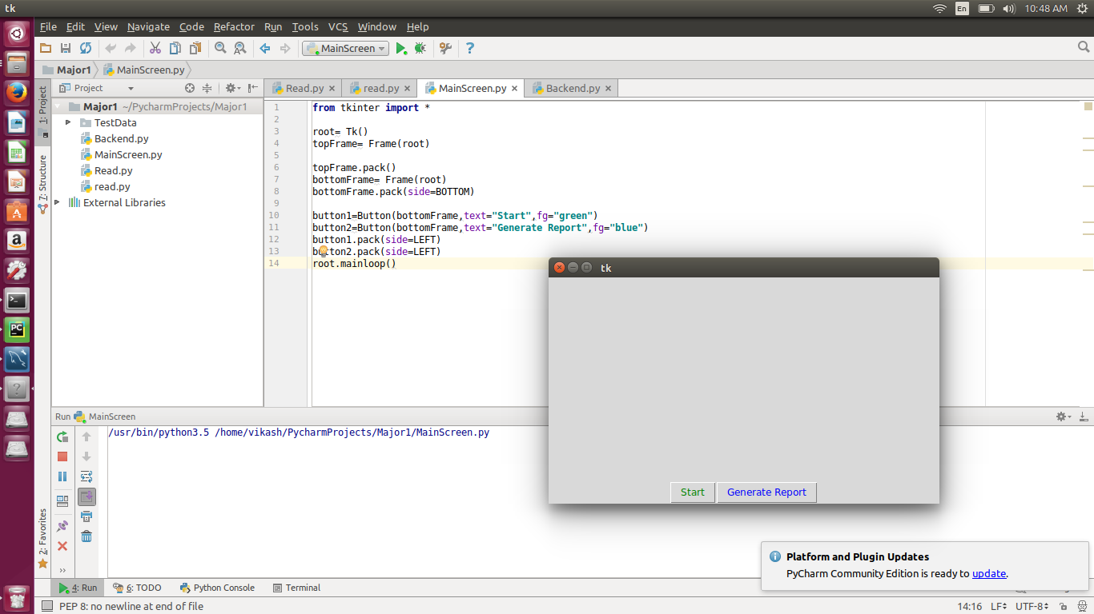
Code (User Interface)

Slide 12
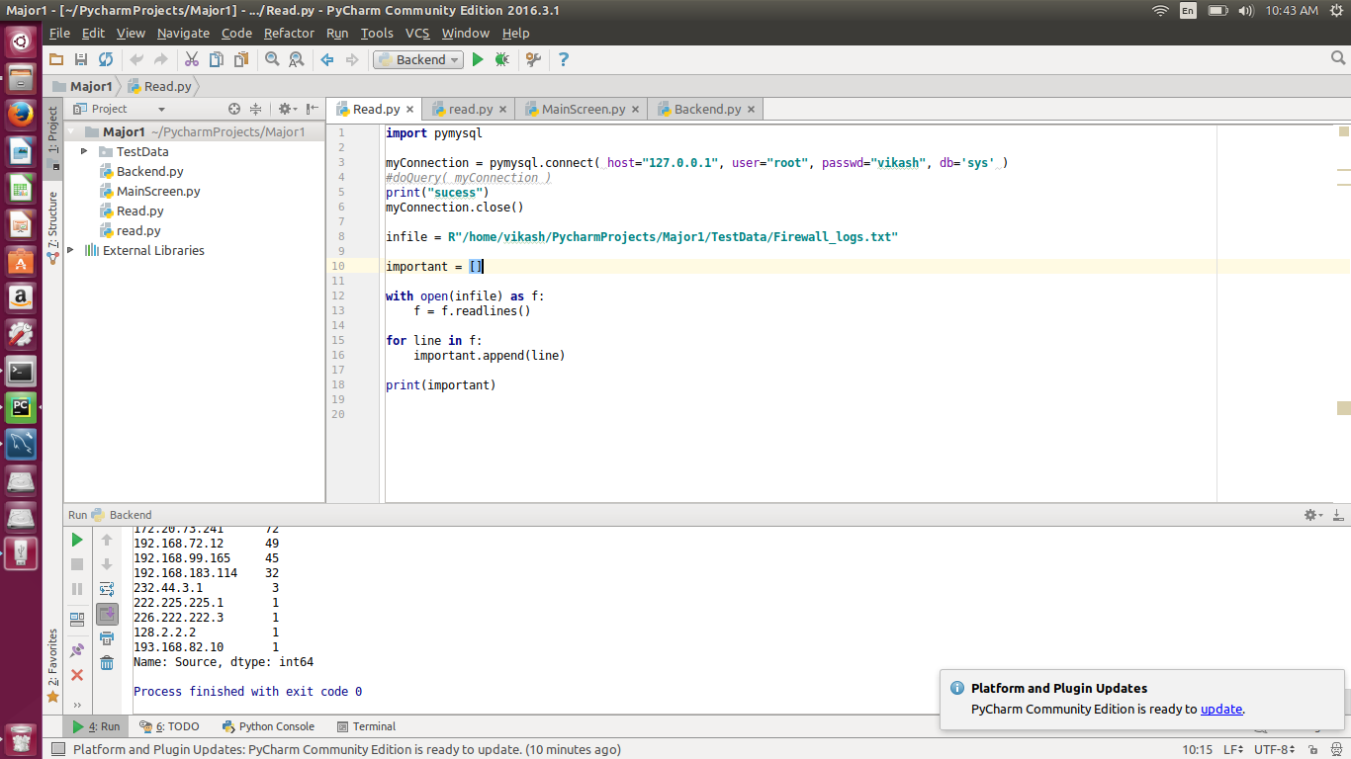
Code

Slide 13
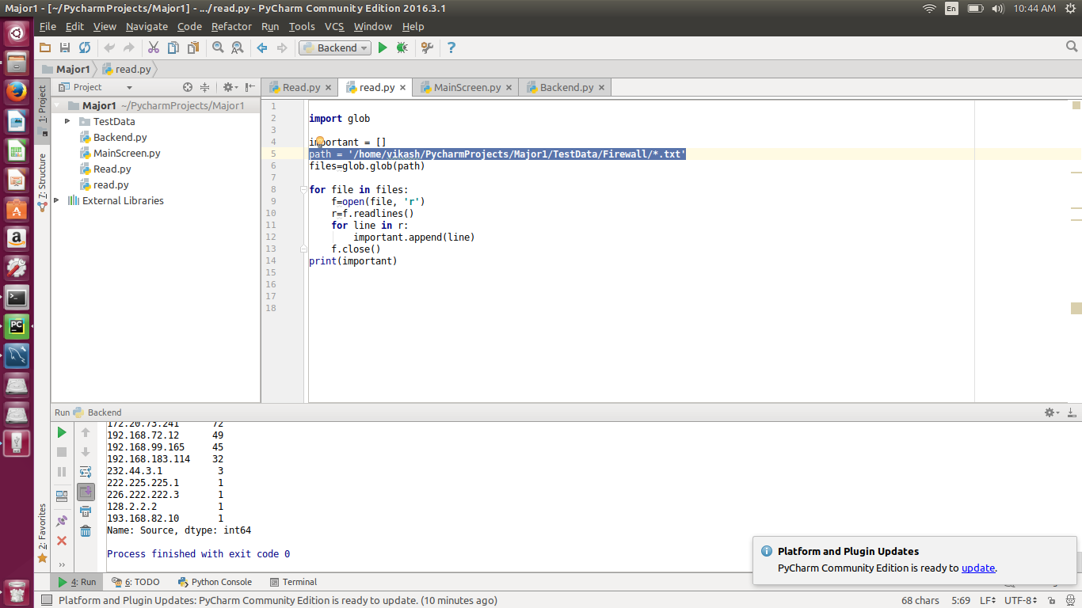
Code

Slide 14
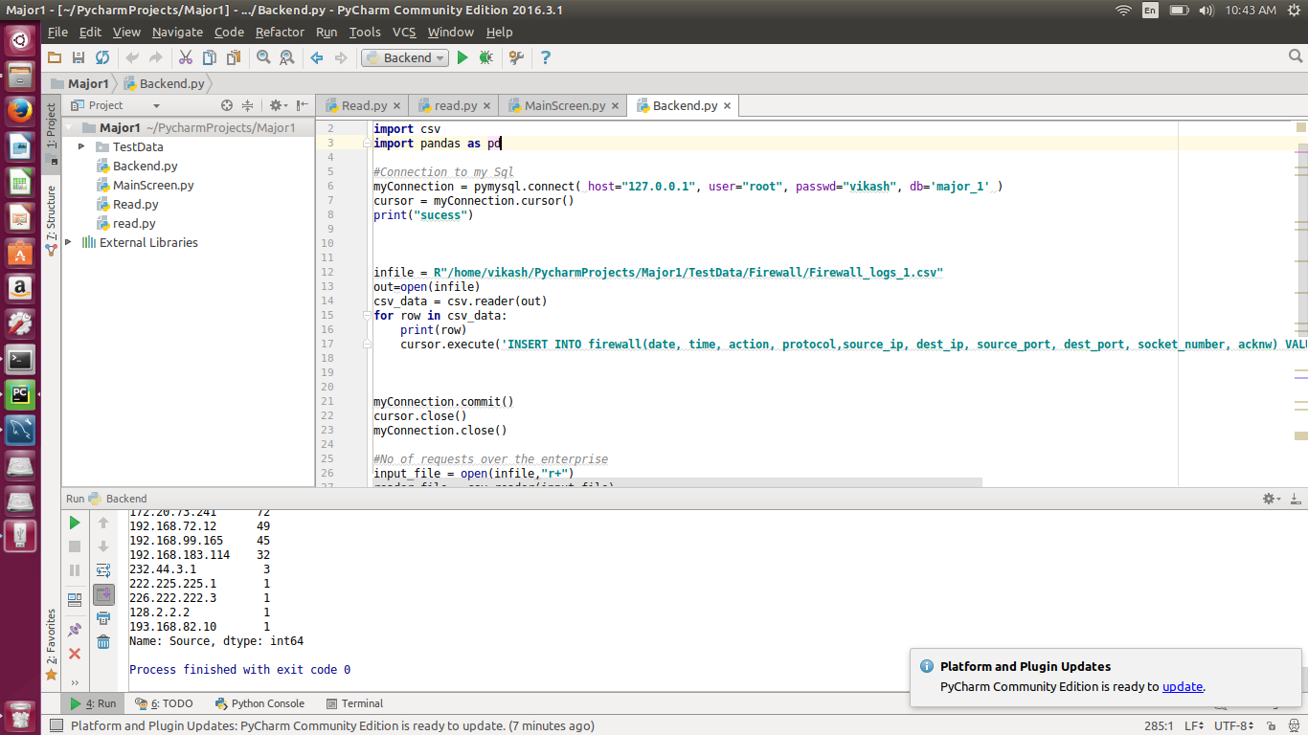
Code

Slide 15
References
“Successful SIEM and Log Management Strategies for Audit and Compliance” Swift, David, 4 November 2010
“Magic Quadrant for Security Information and Event Management” Bussa, Toby & Kavanagh, Kelly, 10 August 2016

Slide 16
Thankyou

